Slide 1
10910EECS204001 Data Structures Homework 3 NTHU OJ 12975
2019/11/9 00:00
~
2019/11/28 23:59

Slide 2
Binary tree representation – S-Expression
Binary tree can be recursively defined
Binary tree = ( root (left_tree)(right_tree) )
Empty binary tree = ()
Binary tree with one node ( 1 ()() )
Binary tree represented as (1(2()())(3()()) )
1
1
2
3

Slide 3
More complicated case
(1 (2()(3()()))(4()()))
Root
Left sub-tree
Right sub-tree
1
2
4
3

Slide 4
(1(2(4()())(5()()))(3(6()())(7()())))
1
2
3
4
5
6
7

Slide 5
HW3
You have to implement the following functions
Traverse
Height
WeightSum
MaximumPathSum
BinaryTower
DeleteLeaf
Foldable
End

Slide 6
Construct a binary tree
Construct a binary tree for the given s-expression
Input: s-expression of a binary tree
(1(2()(3()()))(4()()))
Output: a node, which is the root of the binary tree represented by
input s-expression

Slide 7
Instruction : Traverse
Pre-order traversal
Print every node’s weight in preorder
1 2 4 5 3 6 7
In-order traversal
Print every node’s weight in inorder
4 2 5 1 6 3 7
Post-order traversal
Print every node’s weight in postorder
4 5 2 6 7 3 1
1
2
3
4
5
6
7

Slide 8
Instruction : Height
Evaluate the height of the binary tree
In this example, height = 3
1
2
3
4
5
6
7

Slide 9
Instruction : WeightSum
Calculate sum of all node’s weight
In this example, weightsum = 28
1
2
3
4
5
6
7

Slide 10
Instruction : MaximumPathSum
Calculate the maximum path sum among all Root to Leaf path
In this example, maximumPathSum = 11
1
2
3
4
5
6
7

Slide 11
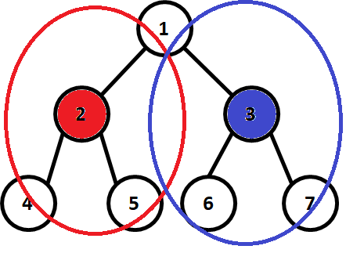
Instruction : BinaryTower
Imagine we can install towers on the nodes of the tree
Each tower can defend its parent, itself and its immediate children
Calculate the minimum number of towers needed to
defend all the nodes in this tree
In this example, BinaryTower = 2

Slide 12
Instruction : Foldable
1
Determine whether a binary tree is foldable or not
Output “Yes” or “No” (without double quotes)
In this example, the binary tree is foldable
p.s. an empty binary tree is foldable
2
3
4
5
6
7

Slide 13
Foldable
without considering node’s weight
A binary tree is foldable iff
left and right sub-trees of the binary tree are structure wise
mirror image of each other
1
1
2
3
2
3
4
5
4
5
A foldable binary tree
Not a foldable binary tree

Slide 14
Instruction : DeleteLeaf
Delete all the leaves in the binary tree
1
2
3
after
1
2
3
4
5
6
7

Slide 15
Hint for constructing the binary tree
Parse the given string to find the root, the left sub-tree and
the right sub-tree.
(1(2(4()())(5()()))(3(6()())(7()())))
Root = 1
Left sub-tree = (2(4()())(5()()))
Right sub-tree = (3(6()())(7()()))
How to identify sub-trees?

Slide 16
Hint for constructing the binary tree
Note that a tree must start with a ‘(‘ and end with a ‘)’
You can use a stack to match ‘(‘ and ‘)’
Push a ‘(‘ in the beginning, and pop when seeing a ’)’
When the stack is empty, a sub-tree is built
Or you can simply use a variable to do this

Slide 17
Input & output
Input
Input is composed by several sets of questions
A set of question will start by a s-expression string, then followed by several instructions that end with the instruction “End”
First you’ll see an s-expression string
Then, you’ll see several instructions
Finally, you’ll see an “End” instruction, and after that you’ll see EOF or next s-expression string
The length of each s-expression is at most 10000000
The number of nodes in each tree is at most 1200000
Each nodes’ weight is between -100000 and 100000

Slide 18
Input & output
Output
Traverse : print preorder, inorder, postorder traversal of the binary tree
Height : print the height of the binary tree
WeightSum : print the sum of all the node’s weight in the binary tree
MaximumPathSum : print the maximum sum among all root to leaf paths of the binary tree
BinaryTower : print the number of towers needed to defend the hole binary tree
DeleteLeaf : delete all the leaves in the binary tree
Foldable : Print “Yes” or “No” Depending on the binary tree foldable or not
**without double quotation mark**
End : End of instructions of this question set.
***The output of every instruction except DeleteLeaf and End should followed by a new line***

Slide 19
Sample input
(1(2(4()())(5()()))(3(6()())(7()())))
Traverse
Height
WeightSum
MaximumPathSum
BinaryTower
Foldable
Delete
Traverse
End
1
2
3
4
5
6
7

Slide 20
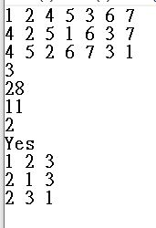
Sample output
Pre Order Traversal
In Order Traversal
Post Order Traversal
Height
WeightSum
MaximumPathSum
BinaryTower
Foldable
After Delete
Pre Order Traversal
InOrder Traversal
Post Order Traversal
End

Slide 21
STL is not allowed to use
<string> is allowed to use
Implement your own stack or utilize variable to parse s-expression
Construct the tree by yourself

Slide 22
The End

